Slide 1

FPGA implementation of cost-effective robust Canny edge detection algorithm
By Sangeetha D. and P. DeePA
Notes:
Make sure to mention the author. D. San-gee-tha
P. Dee-pa

Slide 2
Introduction
Canny edge detector
Comparison with other methods: Robert Detector, Prewitt Detector, Sobel detector, Laplace of Gaussian detector
Notes:
Having an effective edge detection mechanism helps to extract useful information from the image. Implementing edge detection algorithm is difficult due to lighting conditions, interference as noise and limitation of enough processing speed.
Block Level to detect edges without loss. It uses Sobel operator, Gradient Approximation method for the magnitude and orientation, non-maximum suppression, block classification for adaptive thresholding and existing hysterics thresholding. They used pipelining to reduce latency.
---
Sensitive to noise and inaccurate
Prewitt: Similar to Sobel and used 3X3 kernel to detect vertical and horizontal edges using
Sobel: Trying to find the edge or intensity difference based on sobel operators. Tend to be noisy due to the limited kernel usage.
Robert: Uses 2*2 using -1, +1, 0
---
Lack of orientation of edges due to Laplacian filter and error around the corners
Laplacian of Gaussian: using convolution filter and using a kernel with different weighting or using difference of Gaussian
-----
Canny edge detector: (frame-level) Improve other limitation but affected by Computation cost and Latency. Use distributed edge detection that is shown by Qiau Xu. et al which has accuracy issue. Used Gaussian, sobel operator (thinning the edges of the input) …
Based on three preference : good detection, good localization, only one response to a single edge.

Slide 3
Design Strategy
Computation of gradient magnitude and orientation using approximate method.
Block classification techniques.
Adaptive threshold calculation of each block.
Notes:
The paper propose better approximation method to increase the accuracy, block-level detection as proposed in Qiau Xu and a calculation that uses local blocks for high and low threshold approximation , this helps to suppress excessive edges in smooth region and preserve significant edges in high-detailed edges.

Slide 4
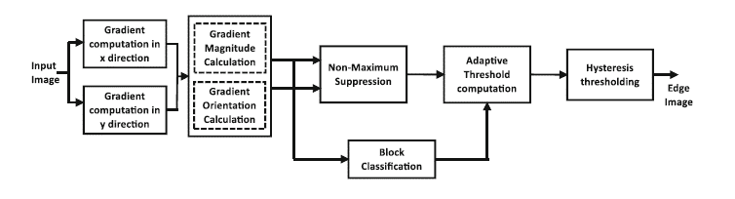
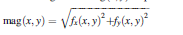
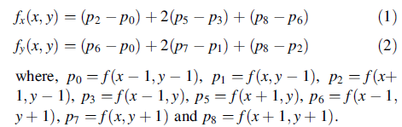
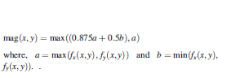
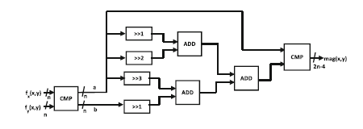
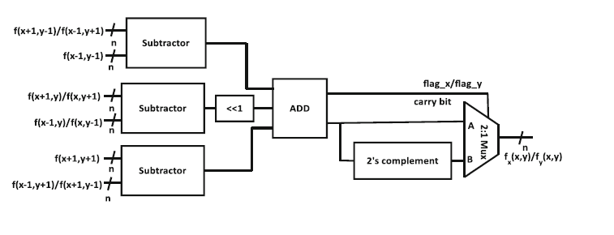
Notes:
[Explain the difference there]
The traditional computation uses separate gradient magnitude and orientation. X and Y are calculated using convolution using gradient mask. The magnitude and direction are related to strength and orientation. Traditionally per pixel calculation is made over here per block. Due to consideration of the thresholds as a whole pictures, there is an introduction of excessive edges even when there is not discontinuity or loss of significant edges. It uses NMS > converts blurred edges to sharp edges by preserving local maxima and surpassing local minima. Hysteresis thresholding remove noise pixle caused by noise and illumination. Compare gradient with thresholds and create continues map.
Proposed
The difference is it is applied on the block level.
MXM is divided to NXN non-overlapping blocks of size mXm with n-bits.
k*k overlapping blocks…k=m+2
Sobel operator is used as a gradient mask since it combines differentiation and Gaussian smoothing. More weight is allocated to pixel intensities around edges. Sobel is not highly accurate for edge identification. So, we use the overflow bit (flag_x/flag_y) to show the sign. If overflow occurs the it is positive and if overflow didn’t occur then it is negative. Negative values are represented by two’s compliment.
The gradient orientation is calculated by taking the tan of fy/fx in a shift operation.

Slide 5
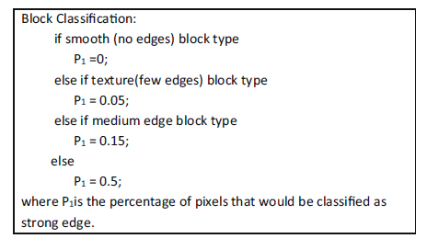
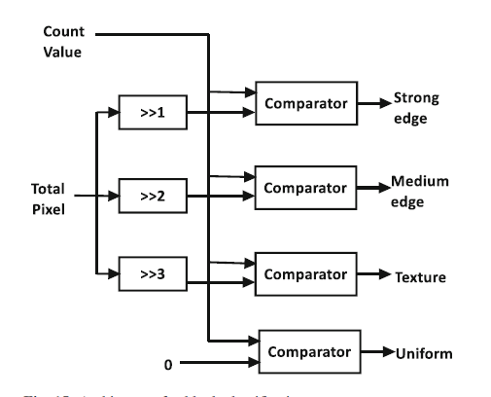
Block Classification
Use local statistics to Label
Edge
Medium edge
Strong edge
Texture

Slide 6
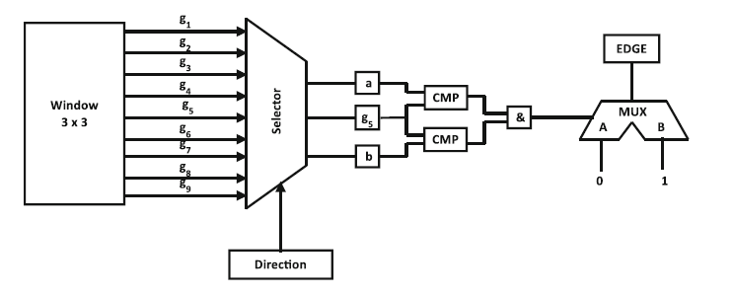
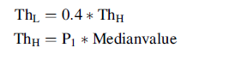
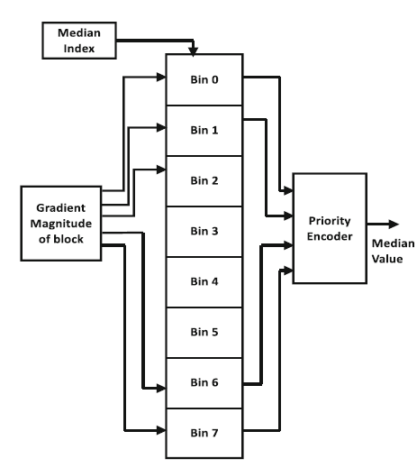
Adaptive Threshold computation
Non-Maximum Suppression
Notes:
It is edge-thinnining to preserve local maxima
Selector finds pixles that are in direction equalivalent to current pixle direction

Slide 7
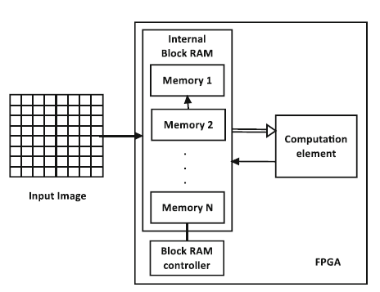
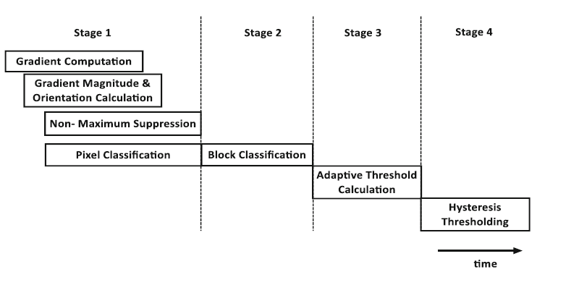
Pipelining Architecture of Computation
VERTICAL AND HORIZONTAL (STAGE 1)
GRADIENT MAGNITUDE AND ORIENTATION(STAGE 1)
NO MAXIMUM SUPPRESION (STAGE 1)
PIXEL CLASSIFICATION(STAGE 1)
BLOCK CLASSIFICATON(STAGE 2)
HIGH AND LOW CALCULATION(STAGE 3)
HYSTERESIS THRESHOLDING(STAGE 4)

Slide 8
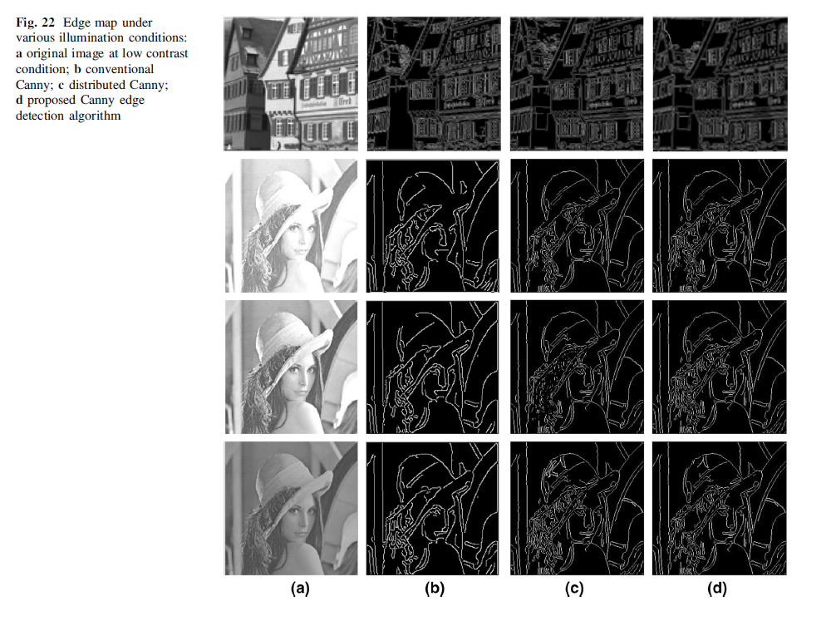
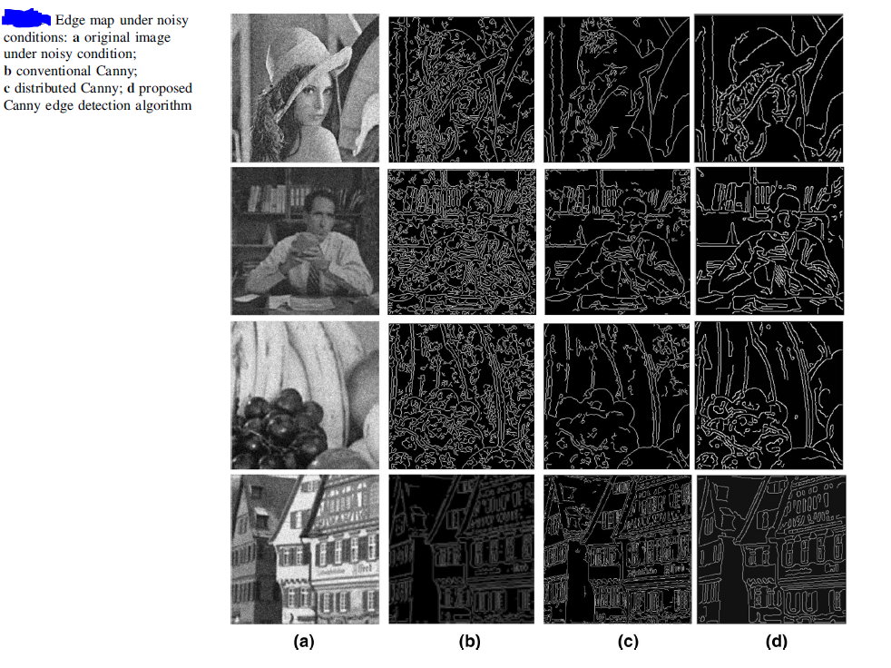
Result and Discussion

Slide 9
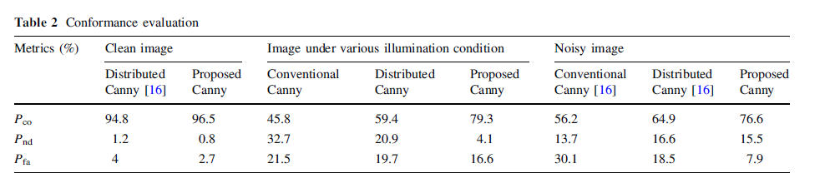
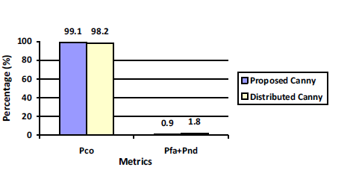
RESULT AND DISCUSSION
ILLUMINATION CHANGES
NOISY IMAGE
CONFORMANCE TEST

Slide 10
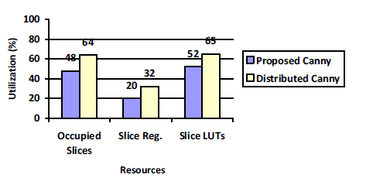
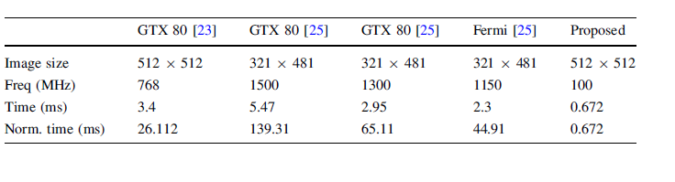
RESOURCE UTILIZATION
EXCUTION TIME

Slide 11
CONCLUSION and future works
FASTER WITH LESS HARDWARE
INEFFICENET FOR SENSATIVE SYSTEMS
FUTURE WORKS TO BE DONE ON WITH HIGHER RESOLUTION PICTURES

Slide 12
reference
Sangeetha, D., & Deepa, P. FPGA implementation of cost-effective robust Canny edge detection algorithm. Journal of Real-Time Image Processing, 1-14.

